Slide 1
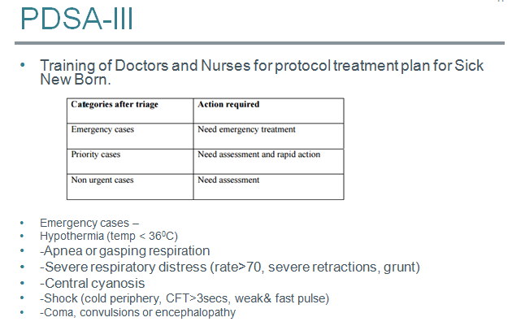
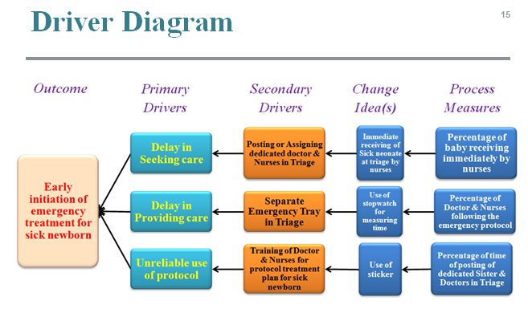
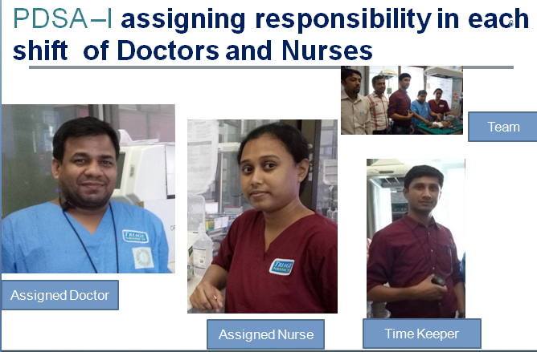
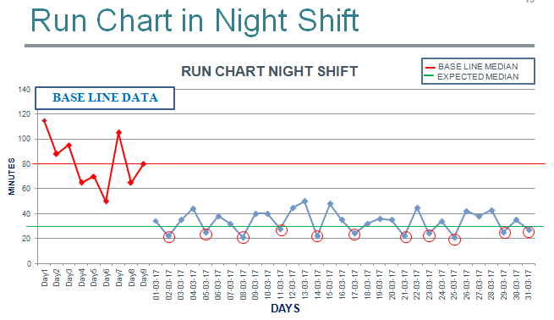
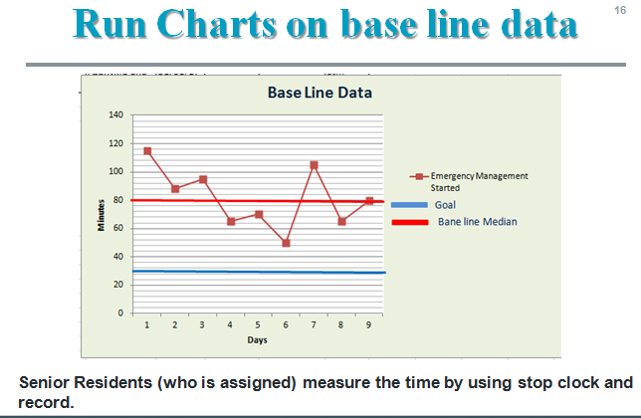
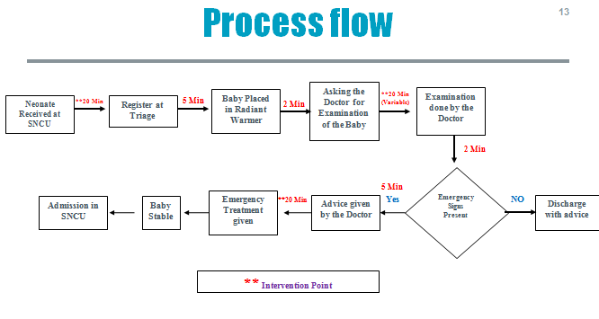
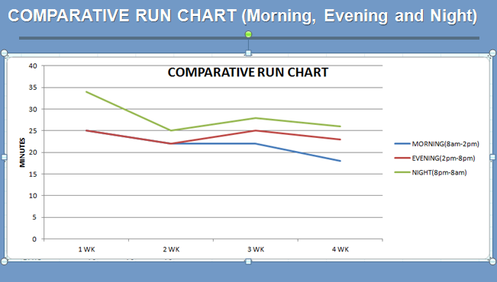
A Quality Improvement initiative for Early Initiation of Emergency Management of Sick Neonate
Nilratan Sircar Medical College & Hospital, Kolkata
TEAM MEMBERS
Dr. Asim Kumar Mallick (Leader ),Dr. Biswajit Mondal (Analyser),Dr. Gopal Pandey (Time Keeper),Dr. Mahammad Kalam (Communicator) ,Bina Acharya(Sister In-charge),Archana Ghosh(Staff Nuress),Sunipa Pramanik(Staff Nuress), Samaresh Kar (DEO)
Background Context & Problem Statement
Root cause analysis (Fish bone)
PDSA Cycle 3
Initiation of emergency treatment of sick new born within 30 minutes will reduces mortality and provide timely treatment . Early treatment will reduce complications ( like organ damage ) thus reduces hospital stay of neonate. It also reduces morbidity and long term sequale in neonate. It reduces the financial burden of the family and as a whole cost of therapy. In a prospective cohort study of 91 infants and children presenting to community hospitals with septic shock (defined by hypotension or delayed capillary refill), each hour delay in initiation of appropriate resuscitation or persistence of hemodynamic abnormalities was associated with a clinically significant increased risk of death (odds ratio [OR] 1.5 and 2.3, respectively)**
*Han YY, Carcillo JA, Dragotta MA, et al. Early reversal of pediatric-neonatal septic shock by community physicians is associated with improved outcome. Pediatrics 2003; 112:793.
Problem Identified
Delay in receiving the sick neonate in triage by Sisters.
No Dedicated person posted in triage.
Delay in processing of admission ticket.
No Separate Emergency tray in triage hence delay.
Aim
To initiate emergency management of all Sick Newborn admitted in our SNCU before 30 minutes (from two hours now) within 8 weeks from current of 20% to 80 % (within 30/04/2017)
Baseline Data Collection
PDSA Cycle 1
To evaluate the incidence of hypothermia in current scenario and how to overcome this problem
Conclusions
Emergency Patient admission more on Evening and Night Shift.
On duty Doctors and Nurses of Evening and night shift are inspired by seeing the morning shift staff success.
Try to implement this module to other shift (Evening & Night) also in future
PDSA Cycle 2
Division of Neonatology, Department of Pediatrics & College of Nursing AIIMS, New Delhi
Notes:
My

