Slide 1
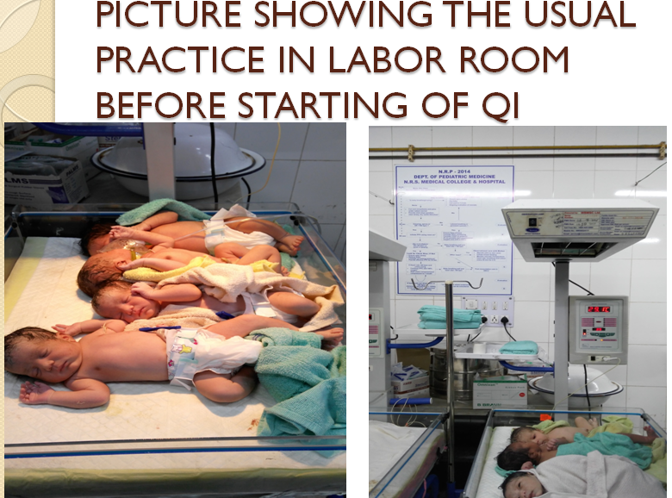
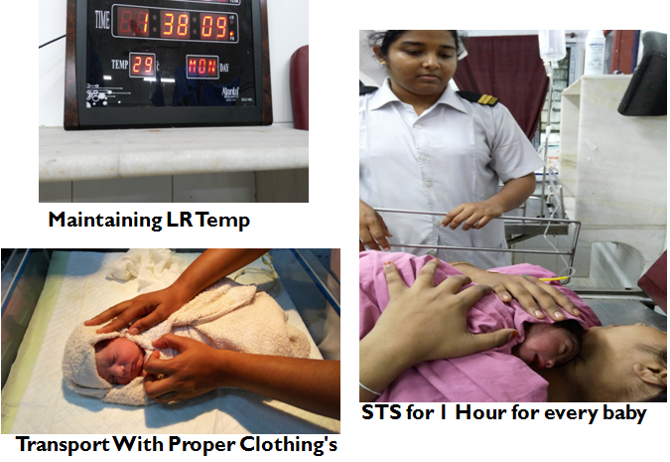
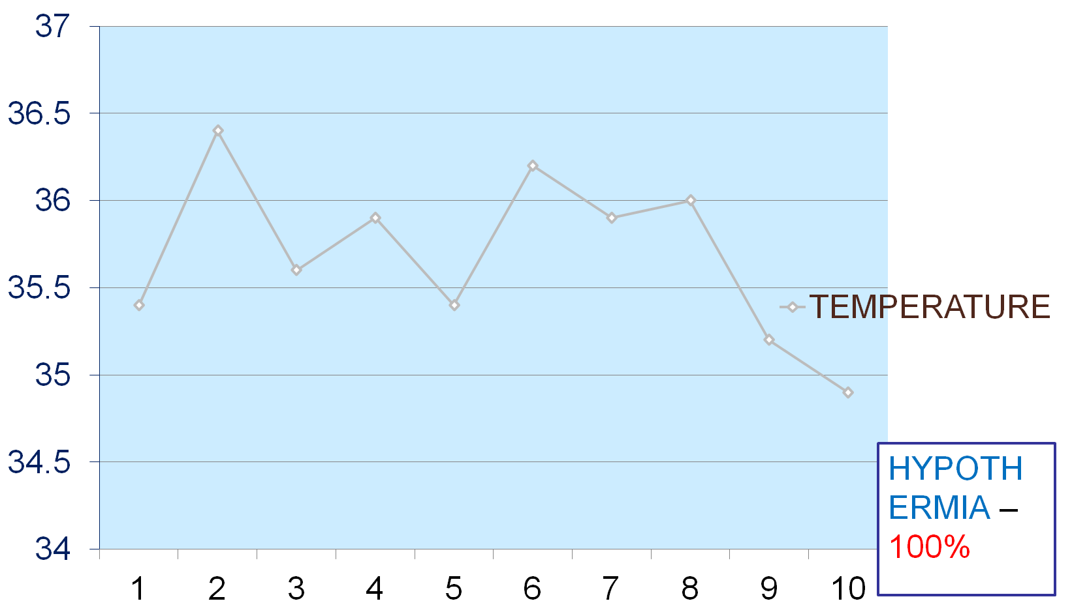
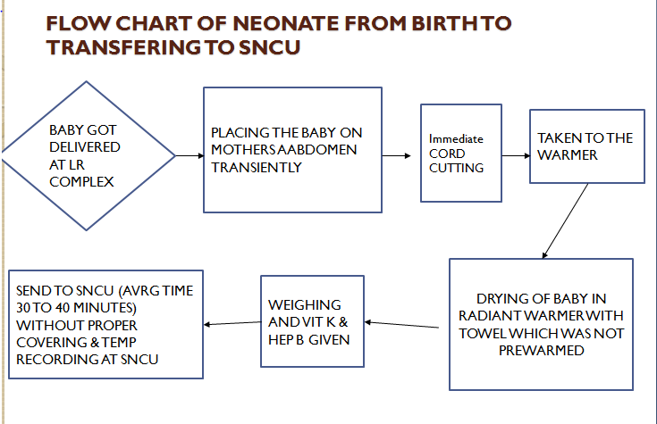
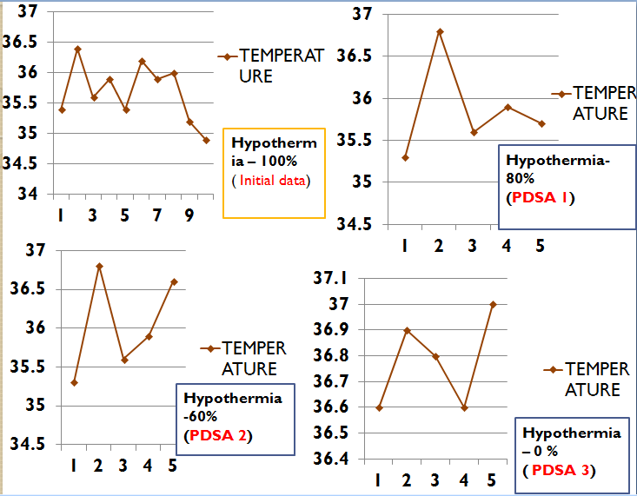
A Quality Improvement initiative to
decrease the incidence of hypothermia of Well Small Baby (weighing 1500- 1800gm) at the time of admission in SNCU
Nilratan Sircar Medical College & Hospital, Kolkata
Background
PDSA Cycle 3
Hypothermia in newborn is defined as body temperature below 36.5⁰ C.
Hypothermia increases the mortality and morbidity. One study from Laptook et al 2007 showed that for every 1º C drop in admission temp the odds of sepsis increased by 11% and mortality by 28%.
Hypothermia predispose a baby to hypoglycaemia, apenia, acidosis, respiratory distress and at late stages bleeding and death.
Hypothermia continues to be a important cause of newborn deaths due to lack of attention by health care provider.
Adopt & sustain the policy of skin to skin contact for every healthy neonates
Skin to skin contact of all healthy newborn staying in LR
Act
Plan
Study
Do
Studied the data and here we achieved great success
All babies were Normothermic during admission in our Unit
Skin to skin contact FOR EVERY NEWBORN minimum for 1 hr
Proper covering of newborn along with mother
Root cause analysis (Fish bone)
Problem Identified
All well small babies weighing 1500-1800gm who are admitted in our SNCU are hypothermic
“This problem was bigger than we thought”
Aim
We aim to decrease the incidence of hypothermia of all healthy newborn weighing 1500g to 1800g at the time admission in SNCU from 100% to 50% by 6 weeks
Baseline Data Collection
PDSA Cycle 1
To evaluate the incidence of hypothermia in current scenario and how to overcome this problem
We are going to do another PDSA cycle as results are not satisfactory
Thermoneutral TEMP
in LR Birth preparation(PREWARMED towel, Delay in Cord clamping Weighing)
Act
Plan
Conclusions
Study
Do
We were able to address problem of hypothermia in well small babies (1500-1800 grams) by conducting multiple PDSA cycles.
PDSA cycle 1 (Thermoneutral LR+ Proper Birth Preparation ) we achieved 20% Hypothermia.
PDSA cycle 2 (Proper covering+ Minimal delay during transport ) there were increase in normothermia by another 20% .
But after PDSA cycle 3 ( STS for 1 Hour) we met with great success and 100% babies were Normothermic
Now we have maintained the sustainability of STS policy in our unit by making a policy and education of nursing staff (new and old)
Studied the effects of environmental modification , Warm birth preparation and increasing the awareness among HCP
Reduction of hypothermia by 20%
Room Thermometer in LR
Maintaining LR Temp Between 26 TO 28 ⁰ C
Adequate supply of prewarmed towel
RECORDING TEMP of The Baby at LR
Increase the AWARENESS of Ancillary staff , SN and Doctors
To follow the NRP INDIA PROTOCOL strictly in
LR
PDSA Cycle 2
We are going to do another PDSA cycle as results are not satisfactory again
TRANSPORT of baby with proper clothing and minimal delay
Act
Plan
Study
Do
After studying the data we saw that Hypothermia still occurring in a significant population of babies i. e. 60%
Adequate supply of PREWARMED TOWELS
Recording of TEMP of the baby at LR
Increase the Awareness of Ancillary Staff ,SN and Doctors Regarding early and proper transport of babies.
WARM
TRANSPORTATION
of all babies
Division of Neonatology, Department of Pediatrics & College of Nursing AIIMS, New Delhi

